Slide 1

2
Harmeet Singh Sehra

Slide 2
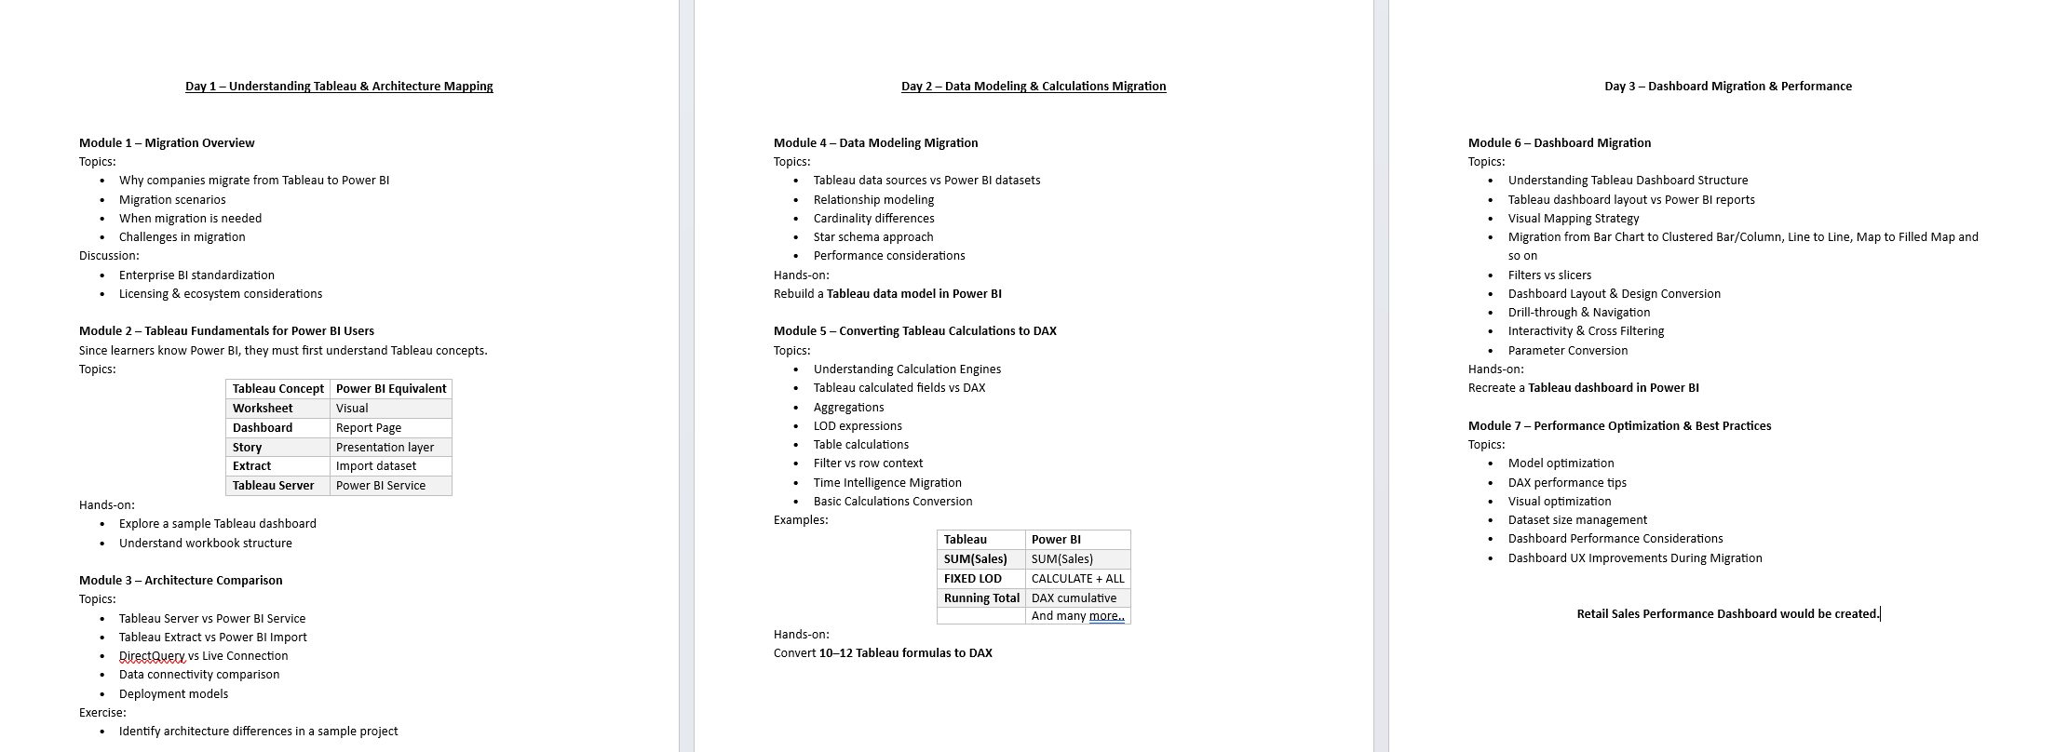
Table of Content

Slide 3
RECAP
Migration scenarios
When migration is needed
Challenges in migration
Discussion:
Enterprise BI standardization
Licensing & ecosystem considerations
Tableau Concept
Worksheet, Dashboard, Story, Shelves, Marks Card, Filters and Show Me Panel
Main Components of Tableau Interface

Slide 4
Day 02’s Agenda
Module 4 – Data Modeling Migration
Topics:
Tableau data sources vs Power BI datasets
Relationship modeling
Cardinality differences
Star schema approach
Performance considerations
Module 5 – Converting Tableau Calculations to DAX
Topics:
Understanding Calculation Engines
Tableau calculated fields vs DAX
Aggregations
LOD expressions
Table calculations
Filter vs row context
Time Intelligence Migration
Basic Calculations Conversion

Slide 5
Data Modeling Migration

Slide 6
Tableau Data Sources vs Power BI Datasets

Slide 7
Tableau
In Tableau, the Data Source is where connections and joins are defined.
Features:
Connects to databases, Excel, CSV, APIs
Supports Live connection or Extract (.hyper)
Joins, unions, and relationships configured in the Data Source tab
Tableau usually builds a logical layer automatically

Slide 8
Power BI
In Power BI, the equivalent concept is a Dataset / Semantic Model.
Features:
Data imported or DirectQuery
Transformations done in Power Query
Relationships managed in Model View
Supports DAX calculations

Slide 9
Tableau | Power BI
Data Source | Dataset
Relationships optional | Relationships mandatory
Calculations mostly at visualization | Calculations mostly at model

Slide 10
Relationship Modeling

Slide 11
Tableau
Tableau introduced Relationships (Logical Layer).
Characteristics:
Tables remain separate
Relationships defined using matching keys
Tableau decides join behavior dynamically

Slide 12
Power BI
Power BI requires explicit relationships.
You define:
Primary Key
Foreign Key
Relationship type

Slide 14
Retail Sales Analysis-Phase-1
Sheet 1: Sales by Region
Chart: Bar Chart
Rows → Region
Columns → SUM(Sales)
Sheet 2: Sales by Category
Chart: Pie Chart
Category vs Sales
Sheet 3: Monthly Sales Trend
Line Chart
OrderDate (Month) vs Sales
Sheet 4: Top 5 Customers
CustomerName vs Sales
Apply Top 5 filter
Sheet 5: Profit vs Sales
Scatter Plot
Sales vs Profit

Slide 15
Retail Sales Analysis-Phase-2
Dashboard Creation

Slide 16
Cardinality Differences

Slide 17
Cardinality describes how tables relate.
Tableau
Cardinality is mostly hidden from the user.
Relationships determine join behavior automatically.
Power BI
Cardinality must be defined.

Slide 18
Star Schema Approach
Power BI strongly prefers Star Schema modeling.

Slide 19
Performance Considerations
Tableau Performance
Performance affected by:
Extract vs Live connection
Number of joins
Data source filters
Visualization complexity

Slide 20
Power BI Performance
Important factors:
Data Model Size
Avoid unnecessary columns
Relationships
Avoid many-to-many
Star Schema
Improves compression
DAX Optimization
Measures faster than calculated columns

Slide 21
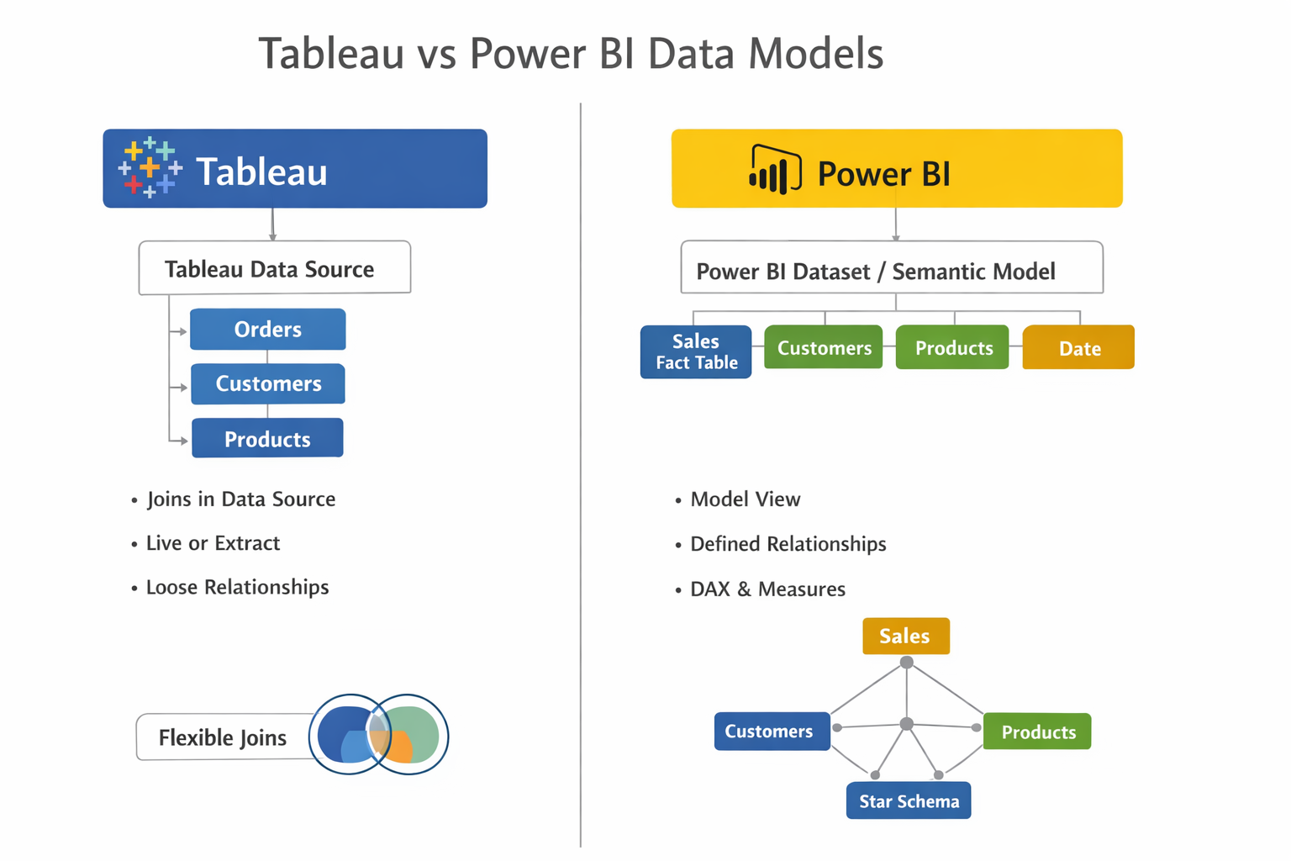

Slide 23
Understanding Calculation Engines

Slide 24
Tableau (VizQL Engine)
Query generated dynamically per visualization
Works visual-first
Aggregation happens automatically in view
Power BI (DAX Engine)
Uses VertiPaq (in-memory columnar engine)
Works model-first
Requires explicit aggregation using DAX

Slide 25
Tableau: “What you see defines the calculation”
Power BI: “Data model defines the calculation”

Slide 26
Tableau Calculated Fields vs DAX

Slide 27
Tableau:
[Profit Ratio] = SUM([Profit]) / SUM([Sales])
Power BI:
Profit Ratio = DIVIDE(SUM(Sales[Profit]), SUM(Sales[Sales]))

Slide 28
Aggregations

Slide 29
Tableau (Auto Aggregation)
SUM([Sales]) AVG([Profit])
DAX (Explicit)
Total Sales = SUM(Sales[Sales]) Avg Profit = AVERAGE(Sales[Profit])
Notes:
👉 Tableau auto-aggregates 👉 DAX requires explicit aggregation

Slide 30
LOD Expressions

Slide 31
What is LOD Expression?
LOD = Level of Detail
“At what level (granularity) should this calculation happen, regardless of what is shown in the view?”
Normally in Tableau:
Calculation depends on what is in the view (e.g., Region, Product, Customer)
BUT…
LOD lets you override that

Slide 32
Example Without LOD
If you create:
SUM([Sales])
👉 Result depends on:
Region → Sales per Region
Product → Sales per Product
👉 So output changes with view

Slide 33
Example WITH LOD
{ FIXED [Region] : SUM([Sales]) }
👉 Now:
Even if you add Customer or Product
It STILL calculates Sales per Region only
👉 View changes ❌ 👉 Calculation stays fixed ✅

Slide 34
Tableau LOD Types
FIXED
INCLUDE
EXCLUDE

Slide 35
FIXED LOD
Tableau
{ FIXED [Region] : SUM([Sales]) }
DAX Equivalent
Sales by Region = CALCULATE( SUM(Sales[Sales]), ALLEXCEPT(Sales, Sales[Region]) )

Slide 36
INCLUDE
Tableau
{ INCLUDE [Customer Name] : SUM([Sales]) }
DAX
👉 Usually handled via visual context OR:
SUM(Sales[Sales])

Slide 37
EXCLUDE
Tableau
{ EXCLUDE [Region] : SUM([Sales]) }
DAX
CALCULATE( SUM(Sales[Sales]), ALL(Sales[Region]) )

Slide 38
Table Calculations

Slide 39
Tableau (Post-aggregation)
RUNNING_SUM(SUM([Sales]))
DAX Equivalent
Running Total = CALCULATE( SUM(Sales[Sales]), FILTER( ALLSELECTED(Sales[Date]), Sales[Date] <= MAX(Sales[Date]) ) )
Notes:
👉 Key Difference:
Tableau → done in visual layer
Power BI → done using DAX measures

Slide 40
Filter Context vs Row Context (CORE CONCEPT)
Tableau
Filters applied visually
Context handled automatically
Power BI
Row Context
Exists in calculated columns

Slide 41
Key Concept – Row Context vs Filter Context in Tableau
Concept | Meaning
Row Context | Working row by row, like in a raw table. Example: [Profit] / [Sales] calculates per row.
Filter Context | The subset of data currently visible in the view after applying filters, dimension selections, or context filters.

Slide 42
Filter Context
Used in measures
Total Sales = SUM(Sales[Sales])
Context Transition
CALCULATE()

Slide 43
Time Intelligence Migration

Slide 44
Tableau
YEAR([Order Date]) DATETRUNC('month', [Order Date])
DAX
Year = YEAR(Sales[Order Date]) Month Start = STARTOFMONTH(Sales[Order Date])

Slide 45
Basic Calculations Conversion

Slide 46
Tableau | DAX
IF [Sales] > 1000 THEN "High" END | IF(SUM(Sales[Sales]) > 1000, "High", BLANK())
ZN([Sales]) | COALESCE(SUM(Sales[Sales]), 0)
ISNULL([Sales]) | ISBLANK(SUM(Sales[Sales]))
LEN([Name]) | LEN(Sales[Name])
LEFT([Name], 3) | LEFT(Sales[Name], 3)

